Slide 1
Use case diagrams

Slide 2
Topics to be covered
Getting Started
Terms and Concepts
Common Modeling Techniques

Slide 3
Introduction
Use case diagrams are one of the five diagrams in the UML for modeling the dynamic aspects of systems.
Use case diagrams are central to modeling the behavior of a system, a subsystem, or a class.
Each one shows a set of use cases and actors and their relationships.

Slide 4
Introduction
We apply use case diagrams to model the use case view of a system.
Use case diagrams are important for visualizing, specifying, and documenting the behavior of an element.
They make systems, subsystems, and classes approachable and understandable by presenting an outside view of how those elements may be used in context.

Slide 5
Introduction
Use case diagrams are also important for testing executable systems through forward engineering and for comprehending executable systems through reverse engineering.

Slide 6
Getting Started
With the UML, we apply use case diagrams to visualize the behavior of a system, subsystem, or class so that users can comprehend how to use that element, and so that developers can implement that element.
As below figure shows, we can provide a use case diagram to model the behavior of that box - which most people would call a cellular phone.

Slide 7
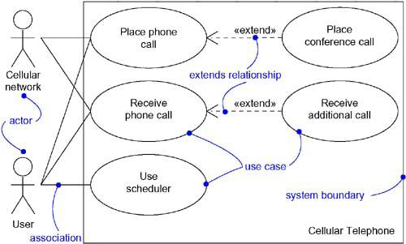
Getting Started

Slide 8
Terms and Concepts
A use case diagram is a diagram that shows a set of use cases and actors and their relationships.

Slide 9
Common Properties
Use case diagrams shares some common properties with the rest of the UML diagrams like a name which identifies a use case diagram and the graphical content which is a projection into a model.
What distinguishes a use case diagram from all other kinds of diagrams is its particular content.

Slide 10
Contents
Use case diagrams commonly contain:
Use cases
Actors
Dependency, generalization and association relationships
Like all other diagrams, use case diagrams may contain notes and constraints.
They may also contain packages or subsystems, which are used to group elements of your model into larger chunks.

Slide 11
Common Uses
We apply use case diagrams to model the static use case view of a system. This view primarily supports the behavior of a system.
When we model the static use case view of a system, we apply use case diagrams in one of the two ways:
To model the context of a system
To model the requirements of a system

Slide 12
Common Modeling Techniques
There are three modeling techniques are there in usecase diagrams
Modeling the Context of a System
Modeling the Requirements of a System
Forward and Reverse Engineering

Slide 13
Modeling the Context of a System
To model the context of a system:
Identify the actors that surround the system.
Organize actors that are similar to one another in a generalization-specialization hierarchy.
For better semantics, provide a stereotype for each actor.
Create a use case diagram with these actors and specify the paths of communication for each actor to the system’s uses cases using association relationships.

Slide 14
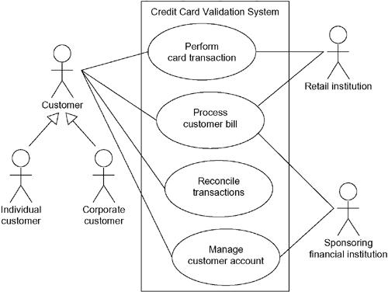
Modeling the Context of a System

Slide 15
Modeling the Requirements of a System
To model the requirements of a system,
Establish the context of the system by identifying the actors that surround (use) the system.
For each actor, identify the behavior that the actor expects from the system or requires the system to provide.
Name these common behaviors as use cases.
Use include and extend relationships to factor common behavior and optional behavior.
Model these use cases, actors and their relationships in a use case diagram.
Use notes to provide details about the use cases and other non-functional requirements.

Slide 16
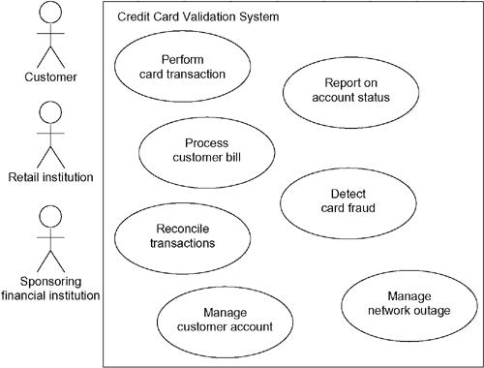
Modeling the Requirements of a System

Slide 17
Forward and Reverse Engineering
Most of the UML's other diagrams, including class, component, and statechart diagrams, are clear candidates for forward and reverse engineering because each has an analog in the executable system
Use case diagrams are a bit different in that they reflect rather than specify the implementation of a system, subsystem, or class.
Use cases describe how an element behaves, not how that behavior is implemented, so it cannot be directly forward or reverse engineered.

Slide 18
Forward Engineering
Forward engineering is the process of transforming a model into code through a mapping to an implementation language.
A use case diagram can be forward engineered to form tests for the element to which it applies.
Each use case in a use case diagram specifies a flow of events, and these flows specify how the element is expected to behave.

Slide 19
Forward Engineering
To forward engineer a use case diagram:
For each use case, identify the flow of events and its exceptional flow of events.
Generate a test script for each flow, using the flow’s preconditions as the test’s initial state and its post conditions as its success criteria.
As necessary, simulate test runs to represent each actor that interacts with the use case.
Use tools to run these tests each time you release the element to which the use case diagram applies.

Slide 20
Reverse Engineering
Reverse engineering is the process of transforming code into a model through a mapping from a specific implementation language.
Automatically reverse engineering a use case diagram is pretty much beyond the state of the art, simply because there is a loss of information when moving from a specification of how an element behaves to how it is implemented.

Slide 21
Reverse Engineering
To reverse engineer a use case diagram,
Identify each actor that interacts with the system.
For each actor, consider how the actor interacts with the system.
Trace the flow of events in the executable system relative to each actor.
Cluster (group) related flows by declaring a corresponding use case. Use include and extend relationships as necessary.
Model these actors and use cases in a use case diagram, and establish their relationships.

